Slide 1
Uber Supply Demand Case Study Submission
Prepared By:
Bhumit Trivedi.

Slide 2
Abstract
In this case study I have analyzed the Pick and Drop data for different drivers during different hours of the day on Airport – City Route for a given period of time.
I have separated the date to observe the patterns evolving on hourly basis. The patters like Requests made, Accepted but no show or Cancelled are computed using R and shown with the help of visualization packages of R.
The results of the analysis provides insights of Time Slot having highest demand on the route and failure of delivering the same.

Slide 3
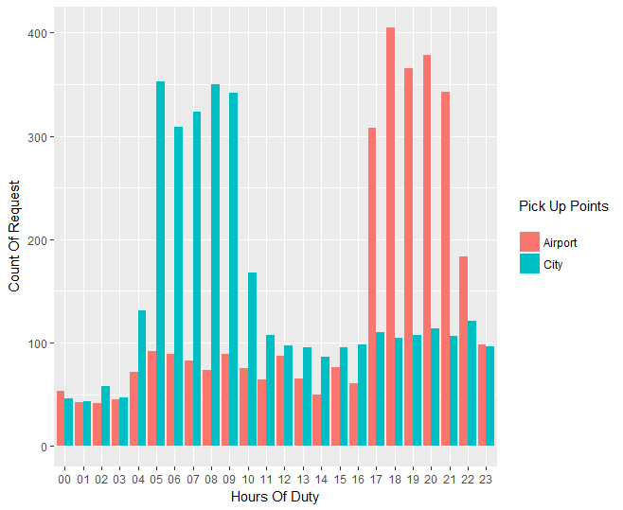
Visualizing most pressing problems
Plot#1
This Bar Chart shows the relation of frequency of Requests made to the Hours in a day for individual Pickup points City and Airport.
By visualization we can conclude that for Airport the number of requests is higher during Evening and for City its higer during Morning. So, we`ll divide our time slots accordingly.
Airport → approx 5 – 10
City → approx 17 – 22

Slide 4
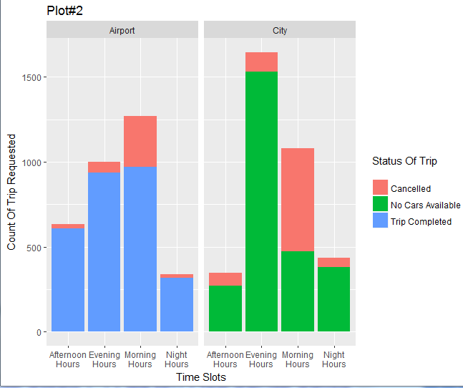
Supply – Demand Gap
This Bar Chart shows the relation of frequency of Requests divided into 3 categories for each bar for respective time slot.
The time slot has been derived to have the hours having the maximum requests count in single time slot.
The Highest count of request has been recorded during Morning for Airport Pickup and Evening for City.
Airport → Evening Hours.
City → Morning Hours.

Slide 5
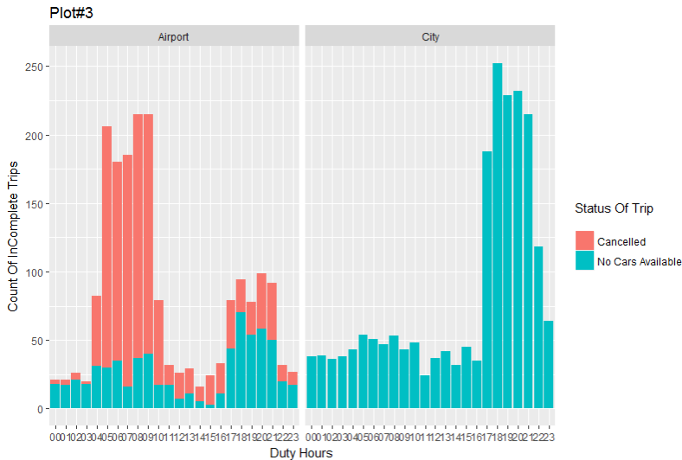
First analyzing the relation between frequency of lack of service during hours of the day.
The visualization shows there is higer amout of lack of service during 4th to 9th hours for Airport Pick up and 17th to 21st hours for City Pick Up.
Airport → 4 am to 9 am.
City → 5 pm to 9 pm.

Slide 6
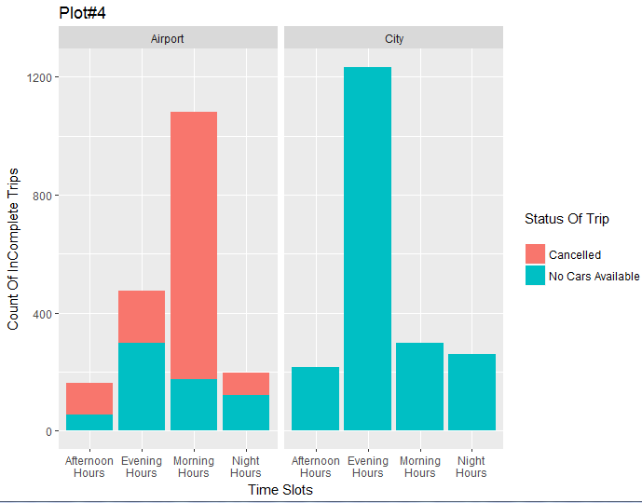
Count of Incomplete Trips w.r.t Time Slot :
The plot shows the relation of Incomplete trips for each time slot.
It shows that for Airport Morning Time slot has highest number of undelivered services.
Where are for pick ups from City huge lack of service is observed during Evening Time Slot.
In face City has higher score for Incomplete Trips than for Airport Pick Ups.
Airport → Morning Slot.
City → Evening Slot.

Slide 7
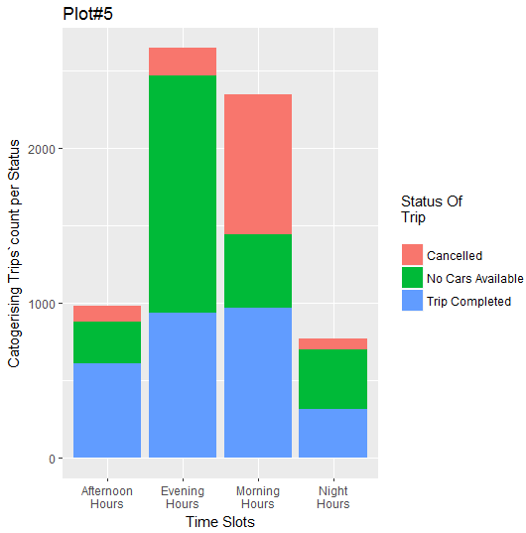
Gap between Supply - Demand :
The plot shows the count of Trips of all the 3 status i.e
Completed
Cancelled
Unavailable
It is visible from the graph the proportional difference between the Trip completed (colour Blue) and other two colors is highest for Bar of Evening Time Slot. The Supply to Demand Gap is Highest for Evening Time slot. From Plot#2, it is visible that the Supply to Demand Gap is More for City Pick Up during Evening Slot.

Slide 8
Reason for Supply – Demand Gap :
Low Frequency of Trips from Airport during Night Time. (refer Plot#1)
Lesser Probability of getting Return Trip.
Explanation:
As shown in Plot#1, the amount of Trips Request from Airport to City is lowest during the time slot of 11pm to 5am. This results in lesser Probability of getting a Return Trip for a driver who Picks up a ride from city during evening hours and will be willing to make a return trip from Airport to City during Night time slot.

Slide 9
Recommendations :
Smart Car Pooling :-
Once the individual cars are out of the city and on common road to Airport, the passengers should share the cars and emptied cars can return.
Driver Incentive for particular time slot :-
The Drivers should be given extra money interms of “Route Allowance” or “Driver Bhatha” for taking rides from City to Airport during Evening time slot.
Decrease fare for Night Time Slot for City to Airport:-
Cheaper Trips during Night Time Slot will encourage passengers to travelling earlier, boost demand during this time slot and will break the Viscous cycle.
Explanation:
As shown in Plot#1, the amount of Trips Request from Airport to City is lowest during the time slot of 11pm to 5am. This results in lesser Probability of getting a Return Trip for a driver who Picks up a ride from city during evening hours and will be willing to make a return trip from Airport to City during Night time slot.

